Slide 1
Hawaiʻi Tobacco Control Policy 2023
HHSP Community Design & Access- Tobacco Break Out
October 25, 2023

Slide 2
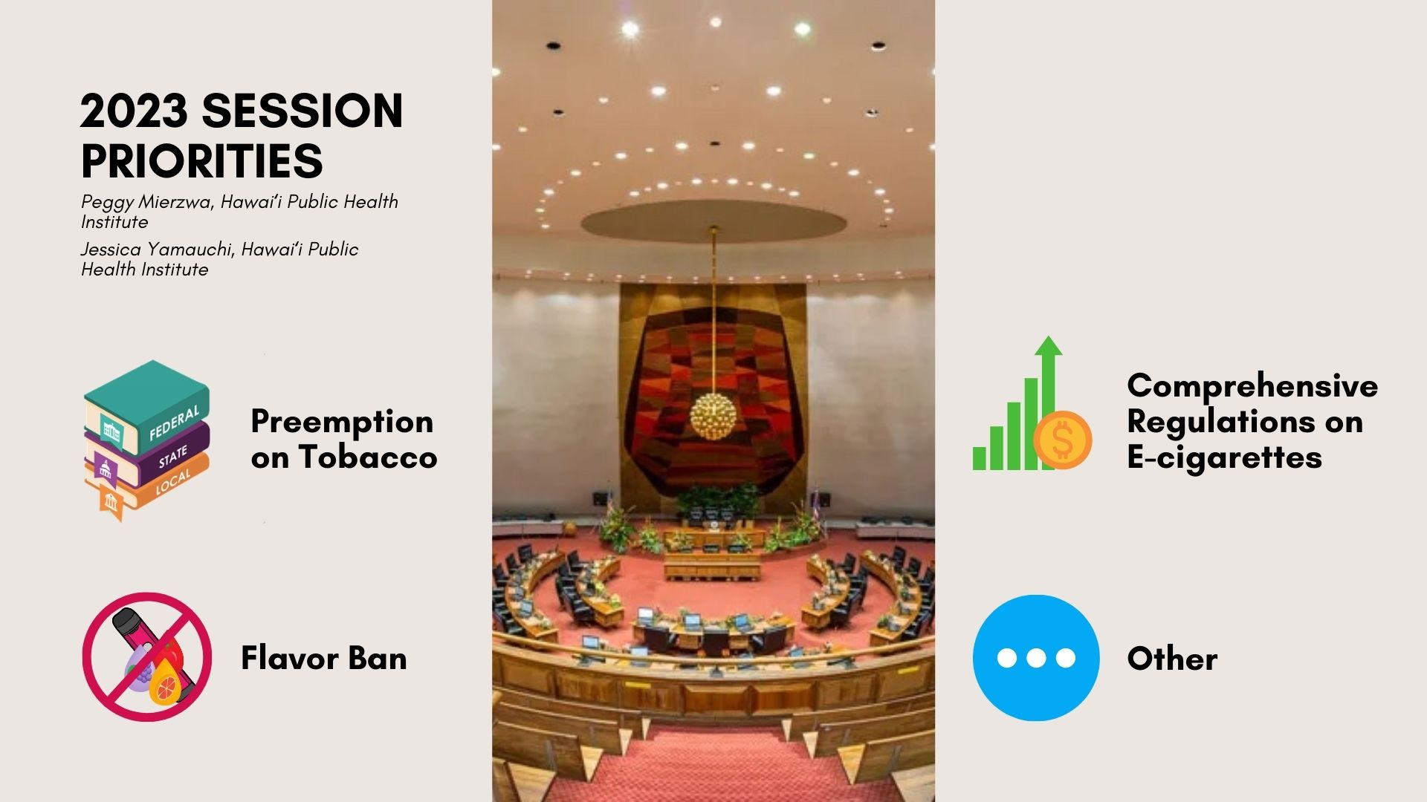
Notes:
Preemption (Jess)
SB 1447 was heard for the first time in 2023.
Bill was confusing. Legislators thought bill will affect taxes on e-cig. Bill didn’t receive a FIN hearing.
There was a lot of county support. Although the bill didn’t pass, it went far, where it was heard in 2 committees in House and Senate
Sen Elefante is a champion on tobacco control
Flavor ban, HB 551 (Scott)
Bill started strong but not heard at FIN
Health chair and committee did not interact or meet with the youth council
Comprehensive Regulations on E-cigarettes, SB 975 (Peggy)
Bill passed
Sen Rhoads introduced the bill and a champion
Rep Tarnas restored the original bill regarding tax and regulating e-cig as tobacco after health committee’s amendments
Enforcement on online sells will start on July 1

Slide 3
Significant bills that did not pass in the 2023 Legislative Session
HB551
Would prohibit the sale of flavored tobacco products and the mislabeling of e-liquids as nicotine free
SB1447
Would reinstate county authority to adopt ordinances that regulate the sale of cigarettes, tobacco products, and electronic smoking devices that do not conflict with and are more stringent than the state law that govern smoking
HB982
Would stabilize and increase funding for the tobacco enforcement unit within the Department of the Attorney General for diligent enforcement efforts and to minimize the risk of losing the master settlement agreement annual payments to the state

Slide 4
SB975 signed into law as Act 62 on June 6, 2023
SB975 creates regulatory parity by including e-cigarettes and e-liquids in the tobacco tax chapter, so the price of e-cigarettes do not entice young people, and prohibits online shipment of e cigarettes to anyone without a tobacco license.
Starting July 1, 2023
Prohibit online sales to anyone without a tobacco license.
Requires e-cigarette and e-liquid wholesalers and dealers to have a tobacco license.
Increases licensing and permitting fees.
Starting January 1, 2024
Adds 70% excise tax on the wholesale price of e-cigarettes and e-liquid products to be paid by wholesalers and dealers.
Requires retailers of e-cigarettes and e-liquids to have a tobacco permit.

Slide 5
Department of Attorney General FAQ on Act 62, SLH 2023

Slide 6
County “Trigger Ban” Efforts

Slide 7
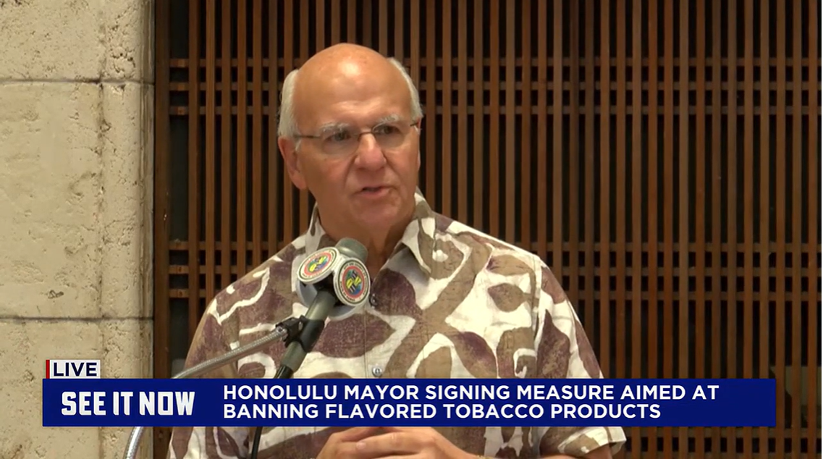
Bill (23)46 – Honolulu City Council
Signed by the Mayor on October 20, 2023
Prohibits the sale of flavored tobacco products, including menthol
Exempts:
  Premium cigars
  Loose leaf tobacco
  Shisha Tobacco products
Goes into effect when the State returns county authority

Slide 8
Bill 46 Debrief
Questions & Comments?

Slide 9
Next Steps Going Forward into Legislative Session 2024

Slide 10
Mahalo!

